Slide 1
Professional Athlete Baseball
By: Brett Anstine

Slide 2
Intro To Career
In the MLB you are playing baseball for a professional team.
You are traveling a lot for this sport.
You get to go to almost every state in the US to play on all of their fields.
You have to get drafted to be in the MLB.

Slide 3
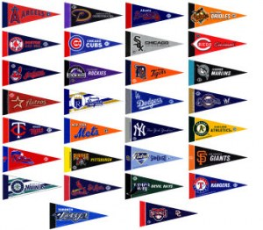
Nature of work
They train for their games mostly everyday.
They work and compete at many different levels.
You don’t want to get hurt Because it could mean losing your job.

Slide 4
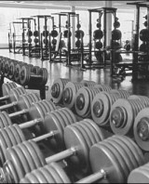
Working Conditions
They Mostly work outside unless they are playing or practicing in a dome.
They will lift weights inside a gym.
They will Be away from home for quite sometime.

Slide 5
Training, Qualifications, And Advancements
You Just need to be good enough to get into the MLB.
You Need to train A lot to get big and strong.
You Need Junior Athlete, College Athlete, and Professional Athlete.

Slide 6
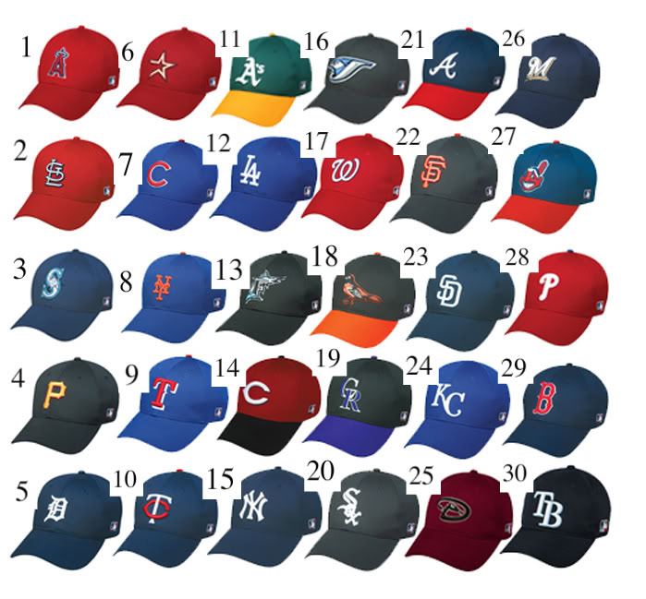
Employment
You can have up to 40 people on a roster and there are 30 MLB teams so that adds up to 1,200 people.

Slide 7
Earnings
They make about 20,000 to 90,000 a year.
If you get into a high League then you will make more money.

Slide 8
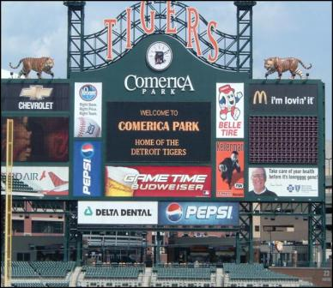
Use Of Technology
They use technology by the scoreboards of how they are electronic or solar powered.
They also use treadmills and other workout machines.

Slide 9
Summary
I would like to do this career because I am athletic.
It fits in with my Personality because I love to play baseball.
Its appealing because I would like to get paid and play a sport when I'm older.

Slide 10
Work Cited
Careercruising.com
http://bit.ly/m1rAeh
http://bit.ly/j19E9O
http://bit.ly/m09ALf
http://bit.ly/lIH2Ne
http://bit.ly/lpcmcr
http://bit.ly/lS5ucc
http://bit.ly/kqmZTQ
http://bit.ly/iw0Nrr

